Slide 1

DAA
Flappy Bird
AI
Teacher : Prof. Pushkar Joglekar
Division : C
Group no : TY 64
(19) Piyush Misal 11920005
(23) Muzammil Rahimi 11811303
(51) Om Patil 11810602

Slide 2
Content
Libraries
Neural Networks
NEAT - Genetic Algorithm

Slide 3
Libraries
pygame
random
time
neat

Slide 4
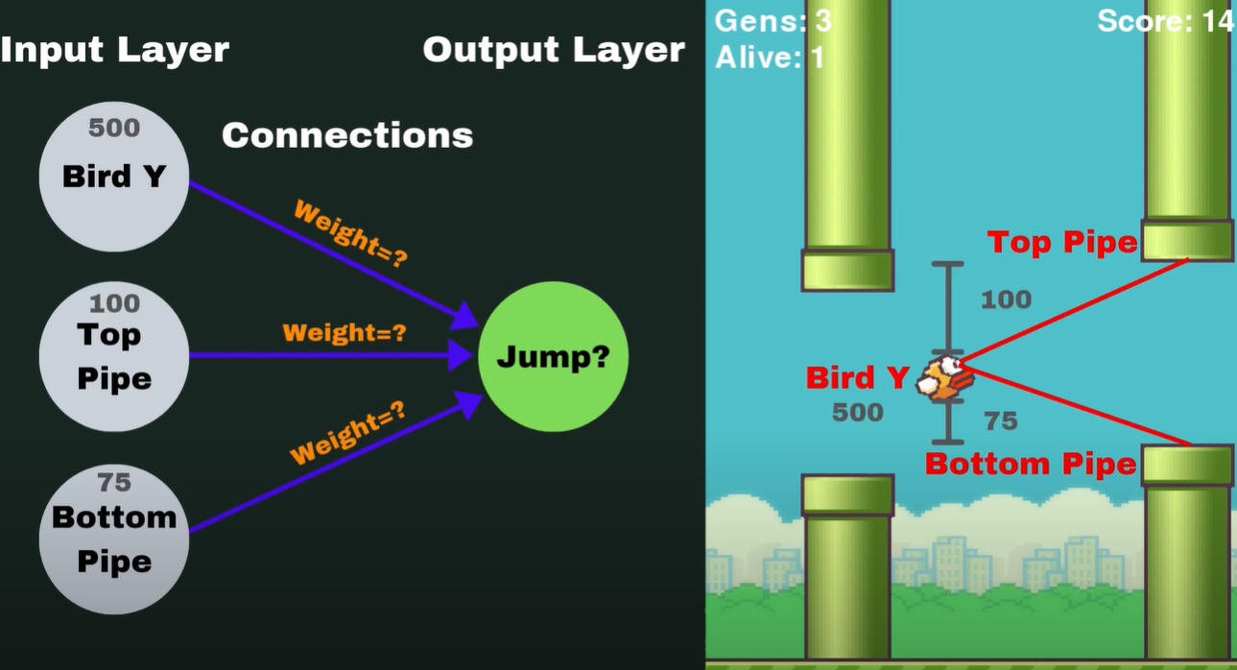
Neural Networks

Slide 5
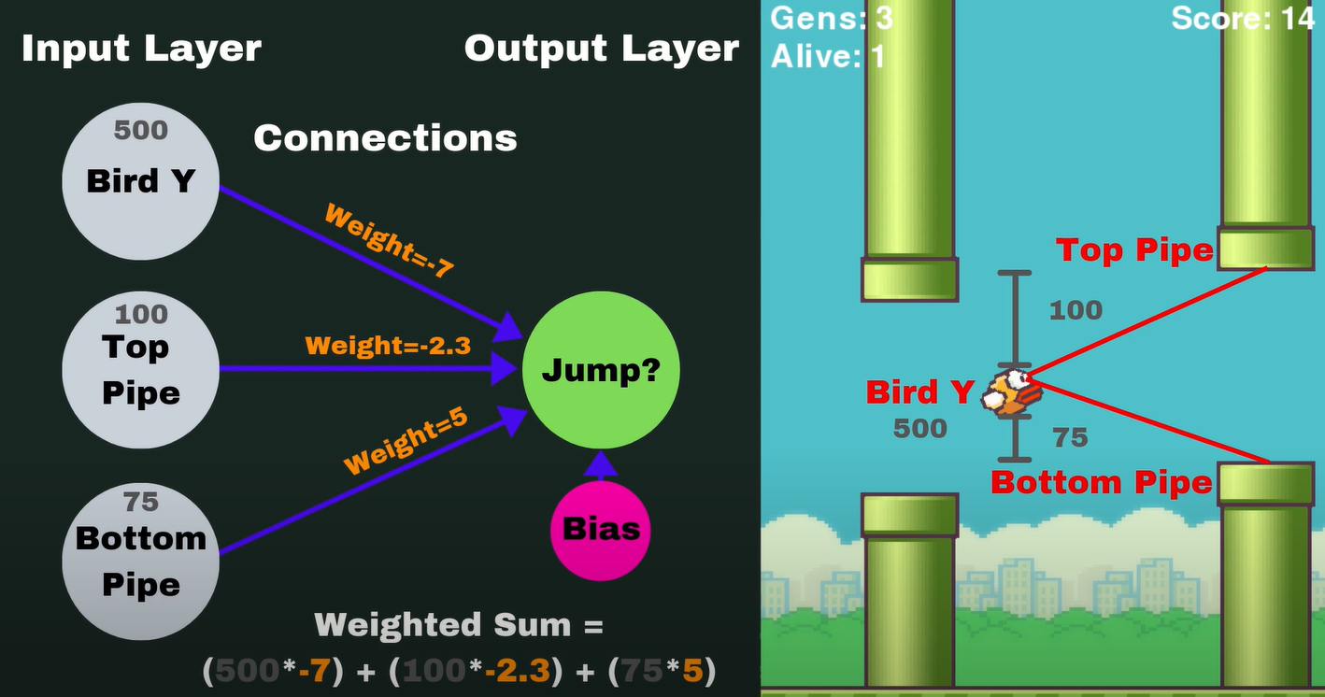
Neural Network

Slide 6
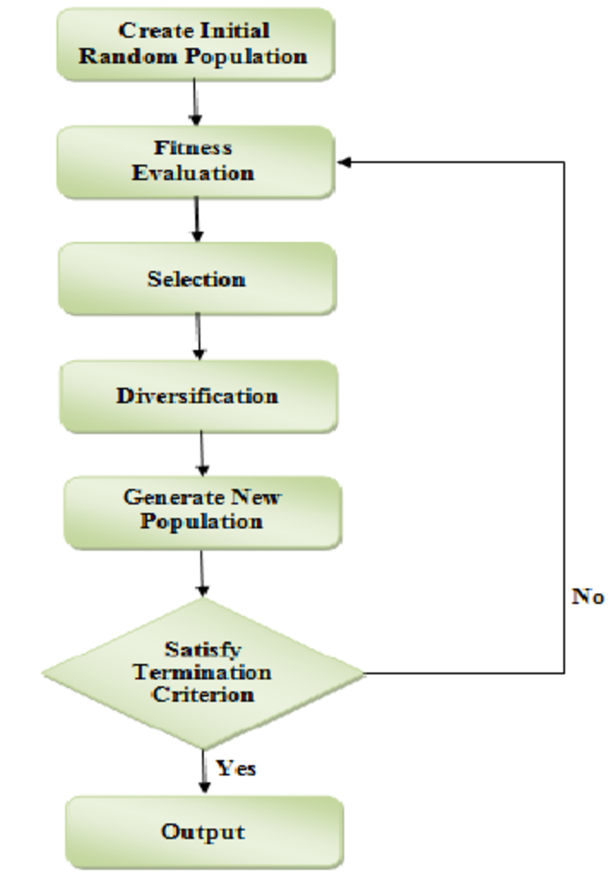
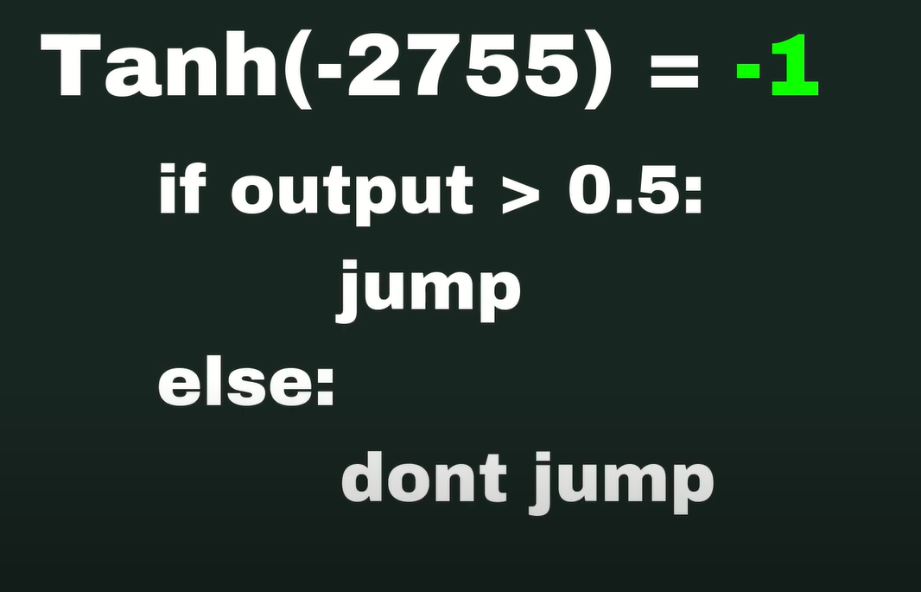
NEAT-Genetic Algorithm

Slide 7
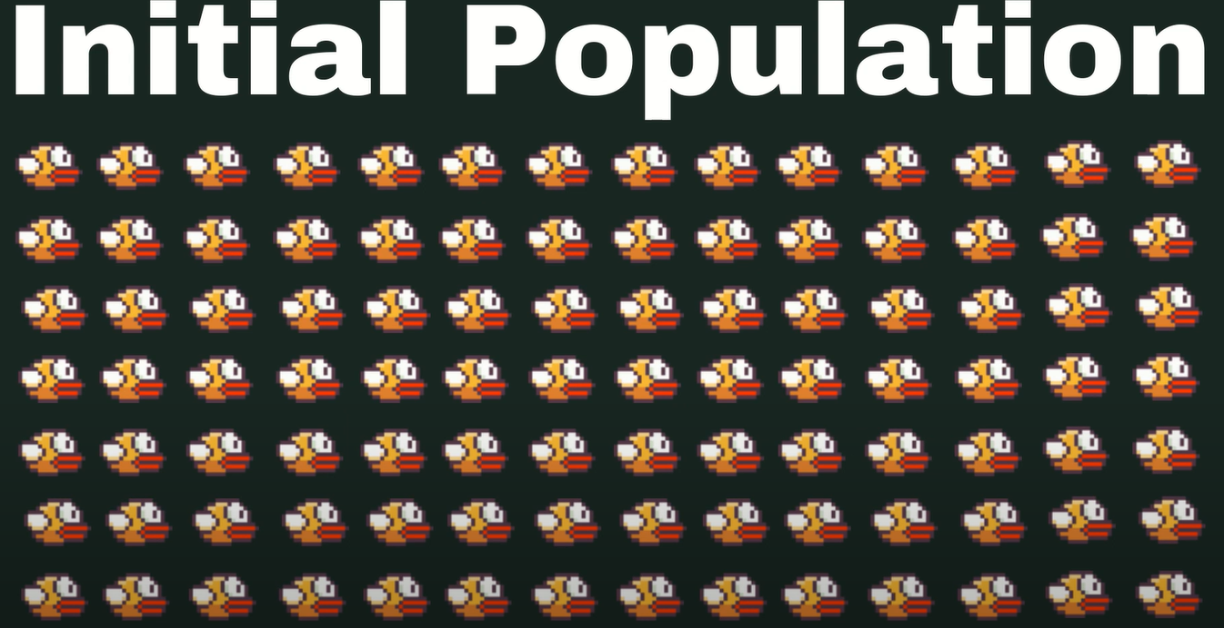
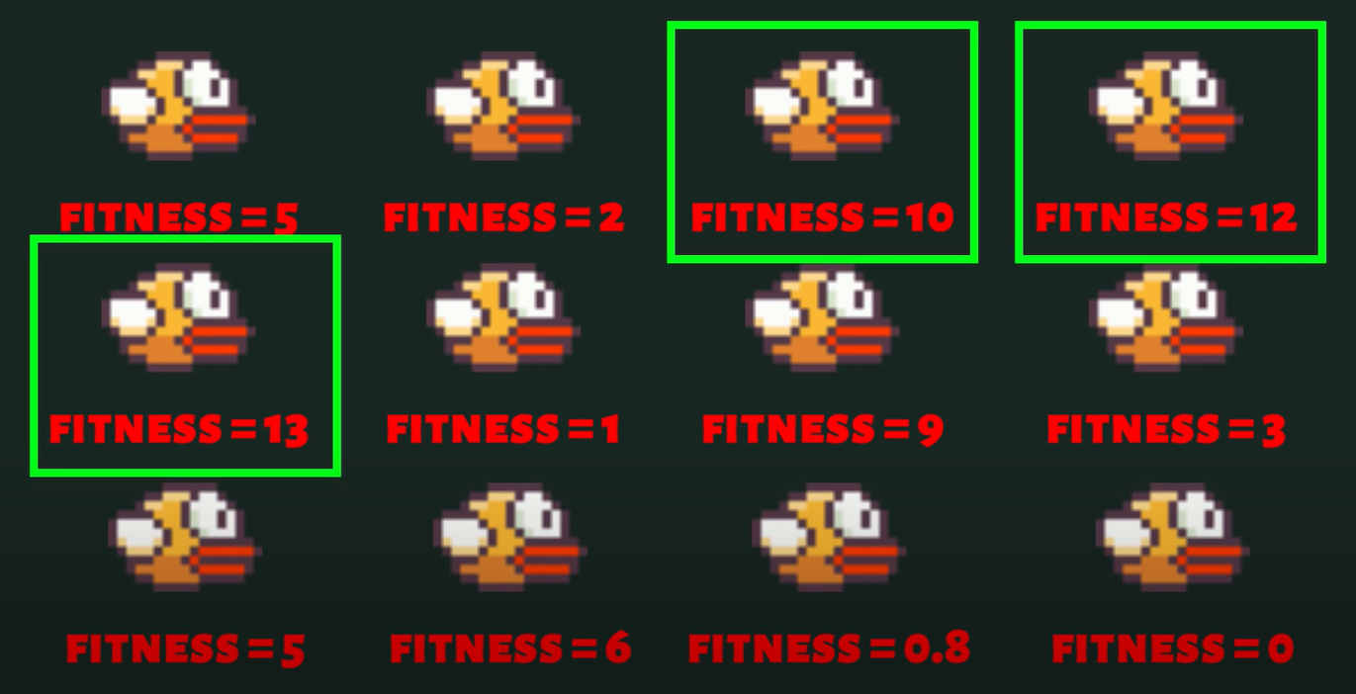
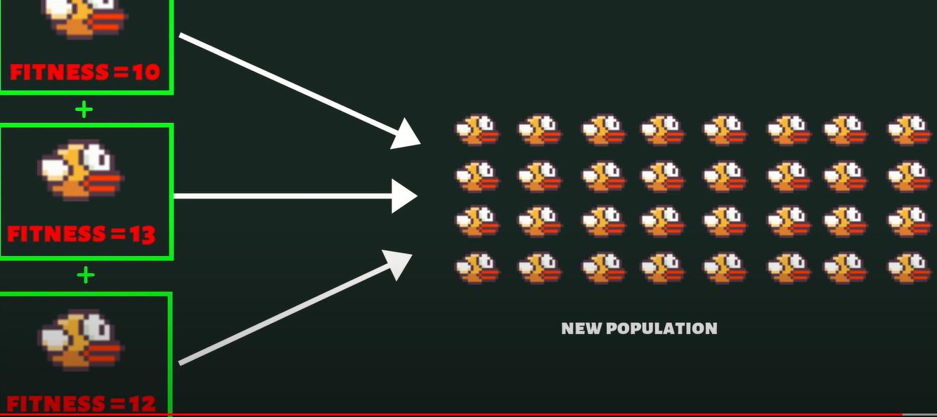
NEAT-Genetic Algorithm

Slide 8
Thank You

